Slide 1
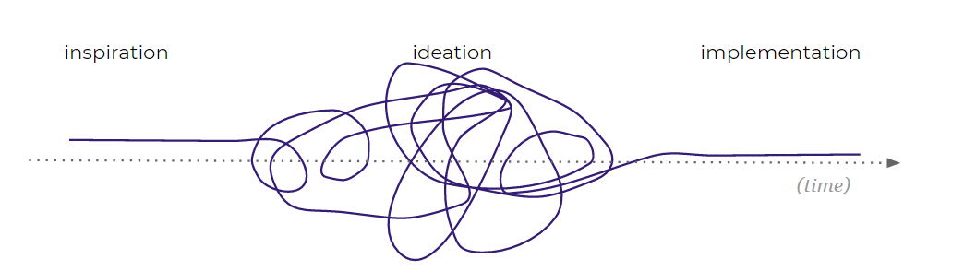
DESIGN THINKING

Slide 2
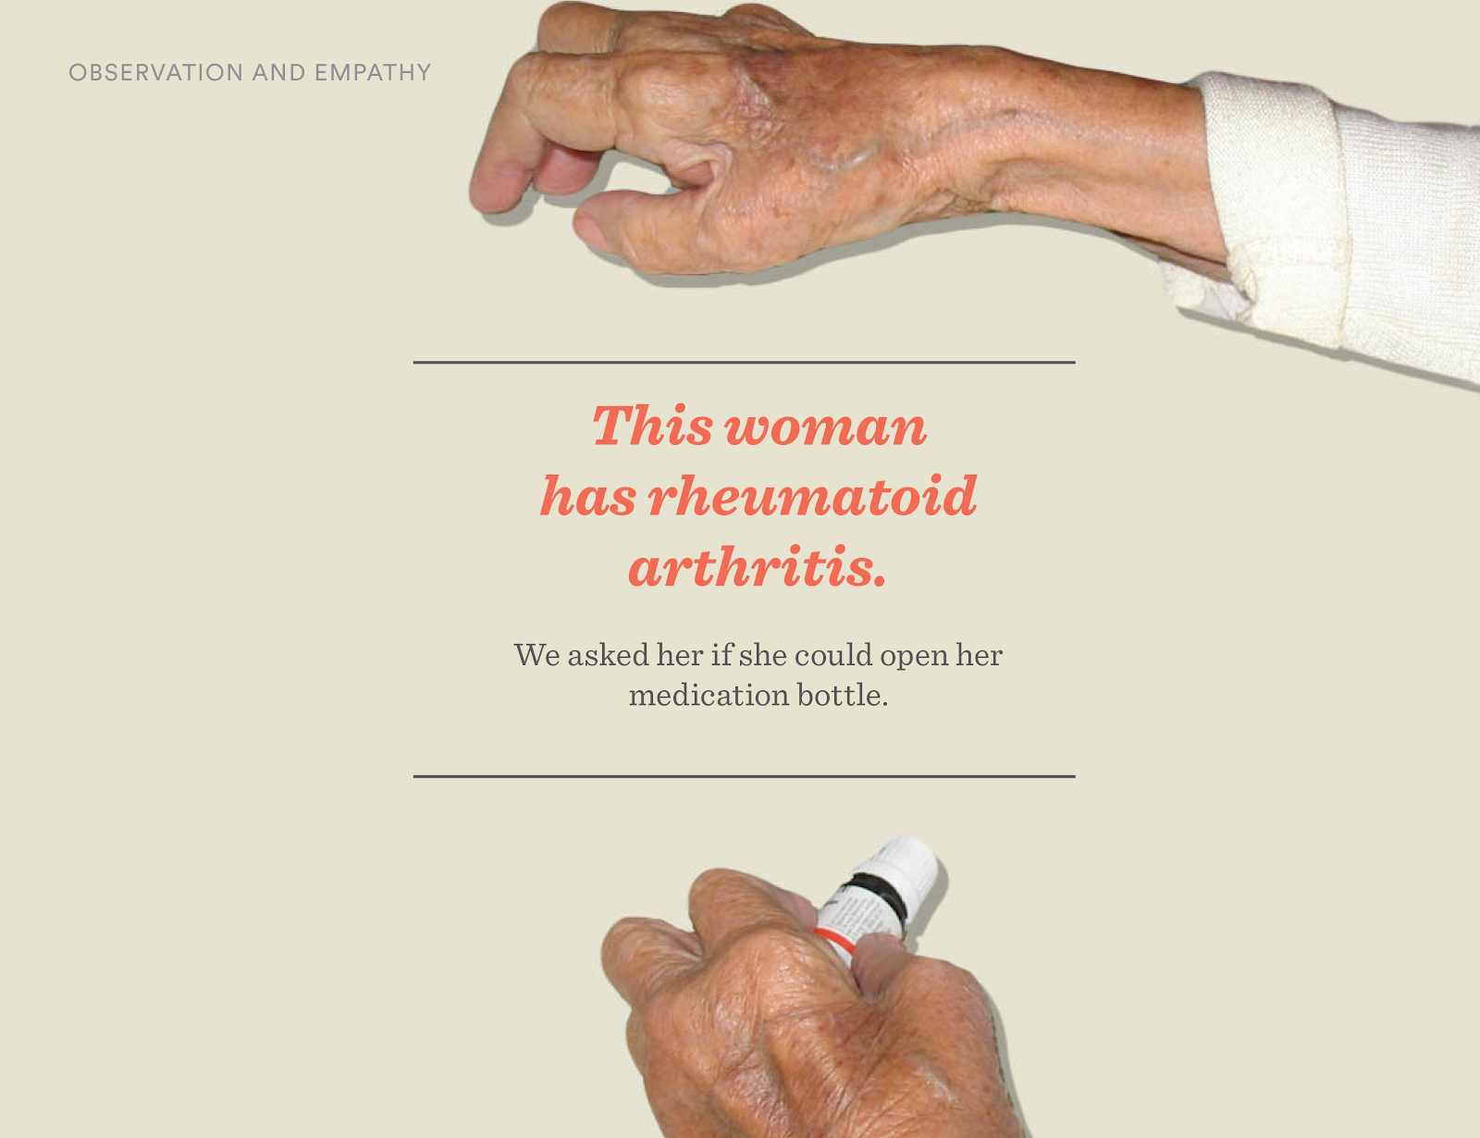

Slide 3
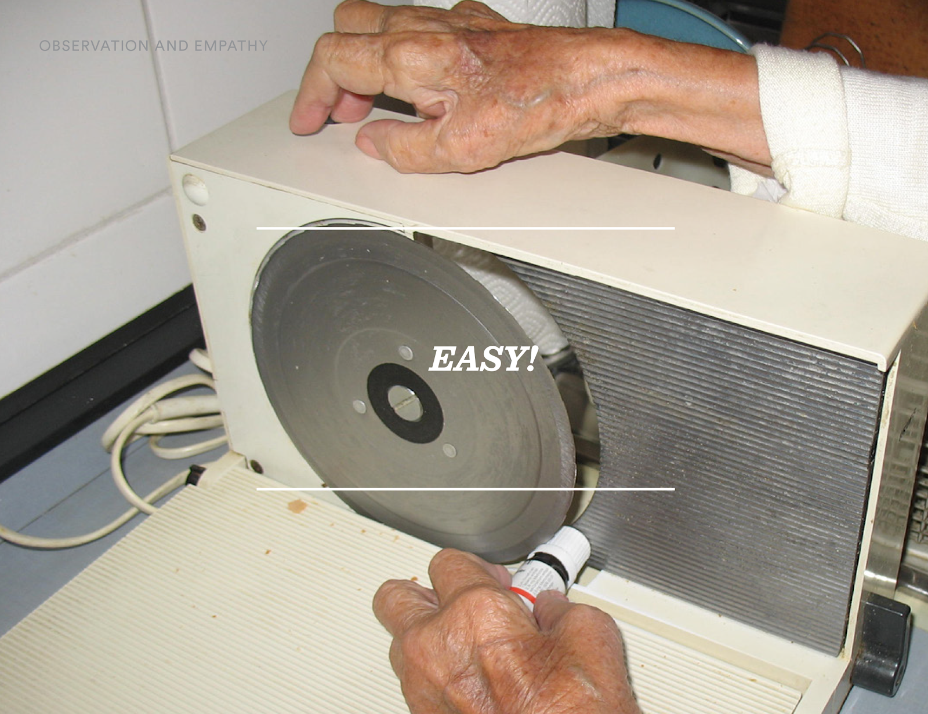

Slide 4
Why can’t we just ask them?
People lie

Slide 5
WHY IS DESIGN THINKING IMPORTANT?
Why Is Design Thinking Important?
It reduces the risk associated with launching new ideas.
It helps organizations learn faster.
It generates solutions that are innovative, not just incremental.
3 Essential Aspects of Design Thinking
Empathy (human-centered)
Ideation (generating a lot of ideas)
Experimentation
Notes:
Design thinking encourages organizations to focus on the people they're creating for.
It’s about simple mindset shifts or ways of asking questions differently – a new way to look at problems.

Slide 6

Design Thinking:
the process
ALIGNMENT
LEARNING
ANALYSIS
IDEATION & ENVISIONING
EVALUATE & REFINE
Focus
Identify problems worth solving
Envision holistic solution
Identify who to interview and how many interviews
Schedule, script, and conduct interviews
Identify themes and insights through affinity mapping
Ideate opportunities and build to solve the problems identified
Test resonance and recommend future roadmap
Notes:
I actually just finished a project in partnership with Yang Wei Neo on BIAV and three URAD Go For Coders where we actually used this process to better understand the interaction points between our Hi Chelsea,
Thanks! Sounds good. Does the Monday after next work for everyone? It looks like it catches us right between travel and FTO ☺
Best,
Maggie

Slide 7
ALIGNMENT
LEARNING
ANALYSIS
IDEATION & ENVISIONING
EVALUATE & REFINE
Alignment
Stakeholder conversations
Notes:
I actually just finished a project in partnership with Yang Wei Neo on BIAV and three URAD Go For Coders where we actually used this process to better understand the interaction points between our Hi Chelsea,
Thanks! Sounds good. Does the Monday after next work for everyone? It looks like it catches us right between travel and FTO ☺
Best,
Maggie

Slide 8
Stakeholder
conversations
What has led us to start this project?
What do we want to learn?
What are we building?
What does success look like?
Notes:
Design thinking encourages organizations to focus on the people they're creating for.
It’s about simple mindset shifts or ways of asking questions differently – a new way to look at problems.

Slide 9
ALIGNMENT
LEARNING
ANALYSIS
IDEATION & ENVISIONING
EVALUATE & REFINE
Learning
Customer research
Notes:
I actually just finished a project in partnership with Yang Wei Neo on BIAV and three URAD Go For Coders where we actually used this process to better understand the interaction points between our Hi Chelsea,
Thanks! Sounds good. Does the Monday after next work for everyone? It looks like it catches us right between travel and FTO ☺
Best,
Maggie

Slide 10
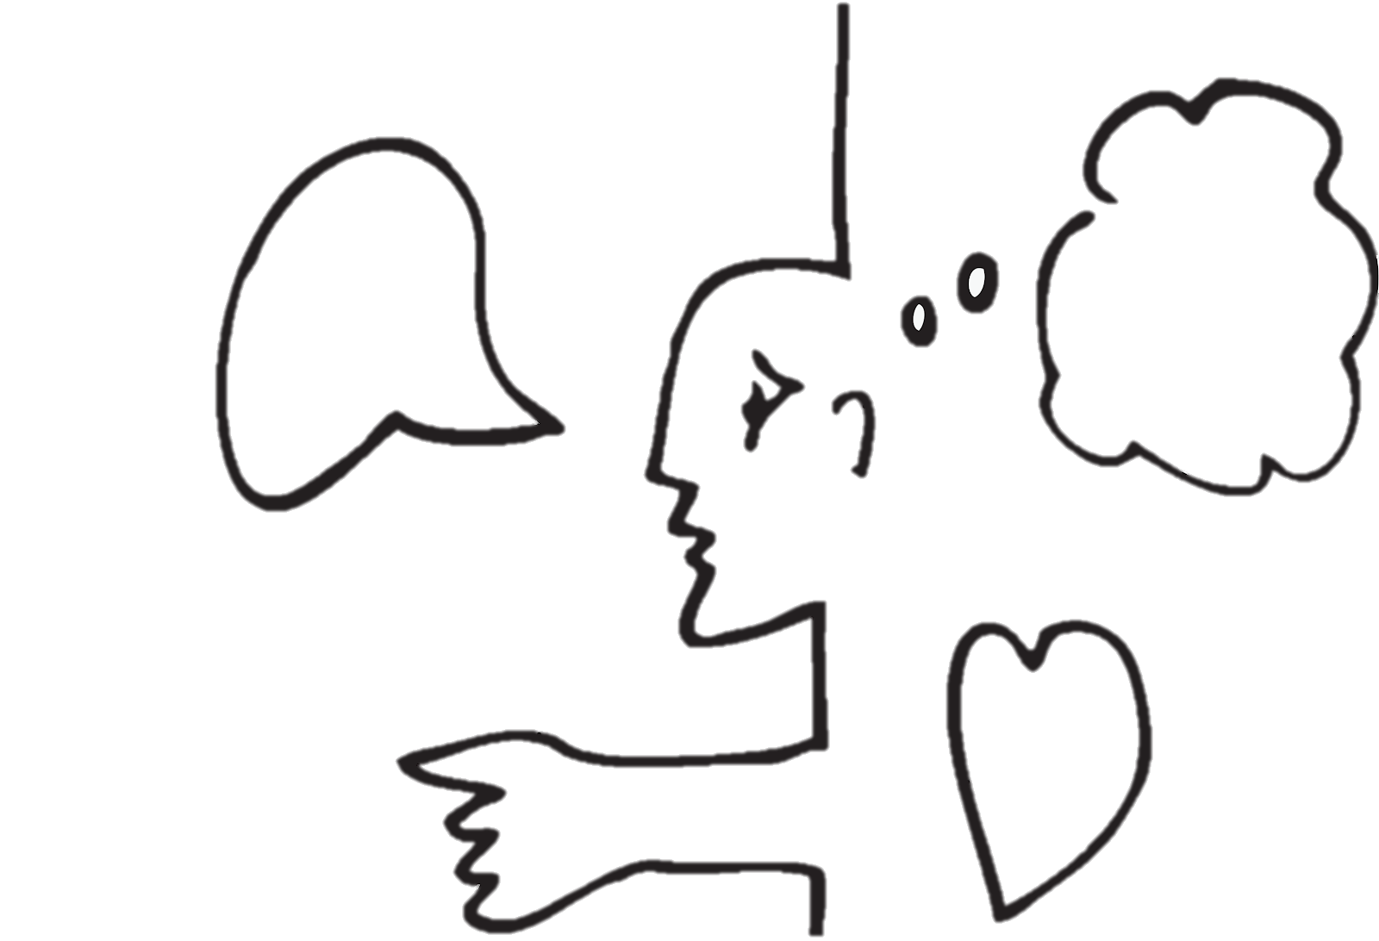
Through observation and empathy, focusing on what people…
say
think
feel
do
use
Notes:
The core of design thinking is getting actionable and knowing your questions. It’s about simple mindset shifts or ways of asking questions differently—a new way to look at problems.

Slide 11
Design thinking
Emotional. Subconscious needs. Experience that aspires to your values
Right Idea
Functional. Conscious needs.
Features that solve a problem
Notes:
Why Is Design Thinking Important?
It reduces the risk associated with launching new ideas.
It helps organizations learn faster.
It generates solutions that are innovative, not just incremental

Slide 12
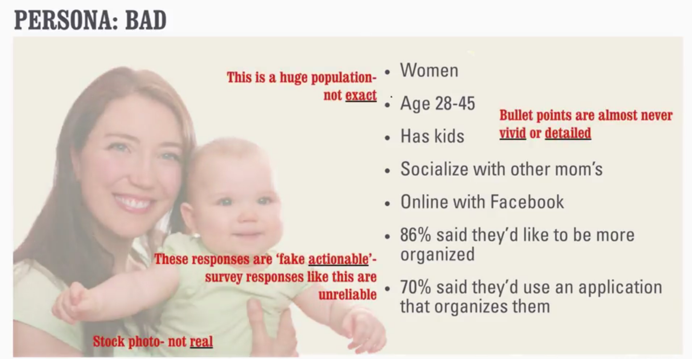
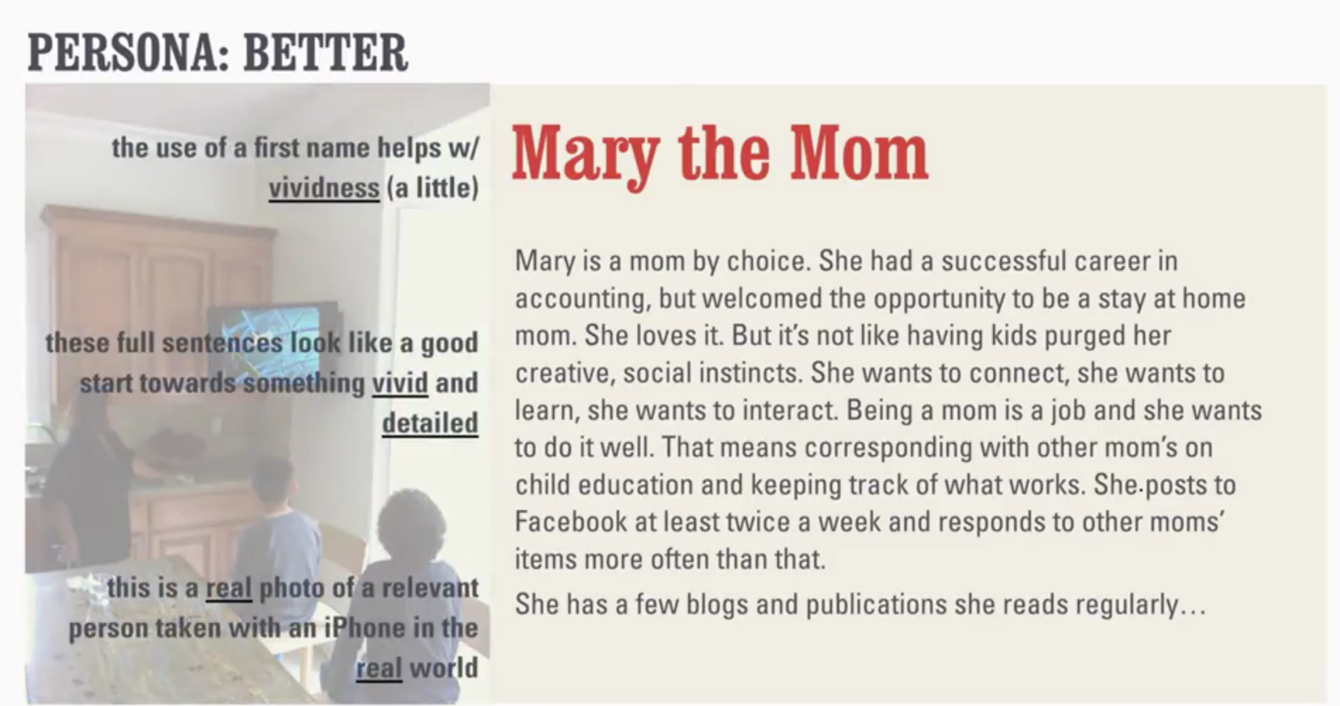
Personas
Bad
Better
Notes:
Why Is Design Thinking Important?
It reduces the risk associated with launching new ideas.
It helps organizations learn faster.
It generates solutions that are innovative, not just incremental

Slide 13
ALIGNMENT
LEARNING
ANALYSIS
IDEATION & ENVISIONING
EVALUATE & REFINE
Analysis
themes and insights
Notes:
I actually just finished a project in partnership with Yang Wei Neo on BIAV and three URAD Go For Coders where we actually used this process to better understand the interaction points between our Hi Chelsea,
Thanks! Sounds good. Does the Monday after next work for everyone? It looks like it catches us right between travel and FTO ☺
Best,
Maggie

Slide 14
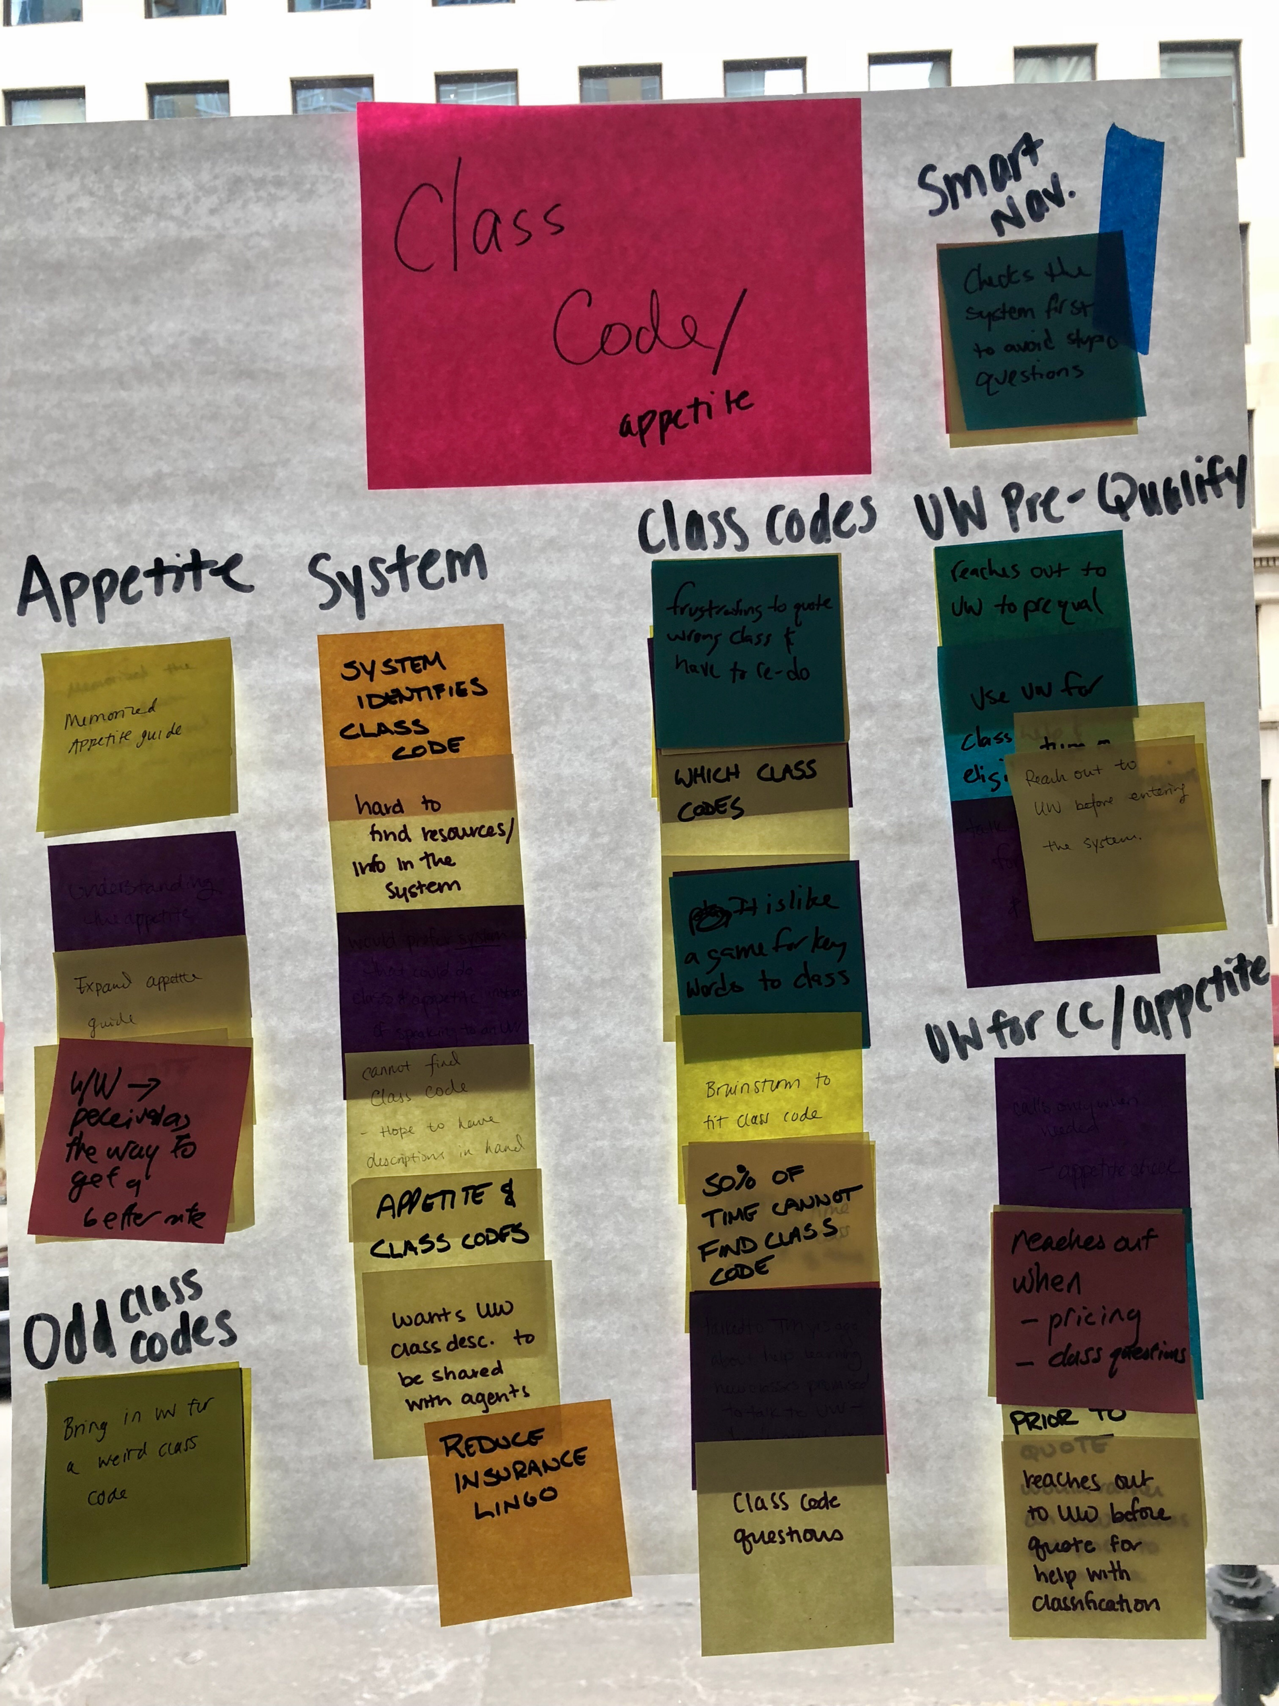

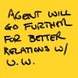
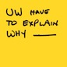


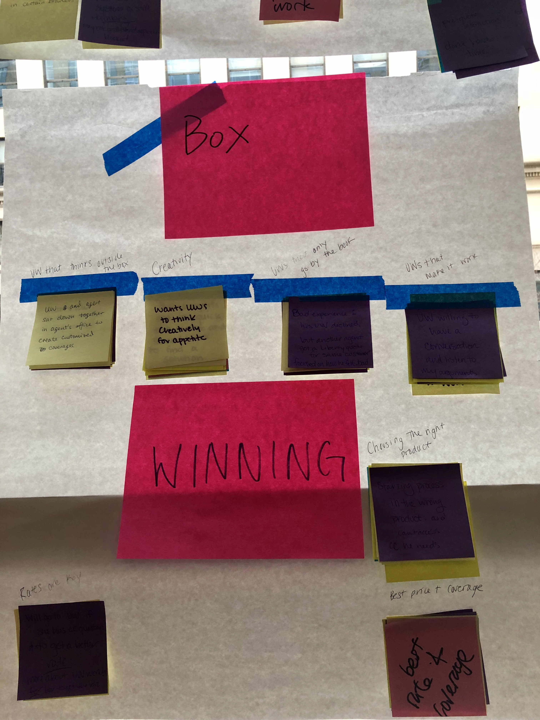
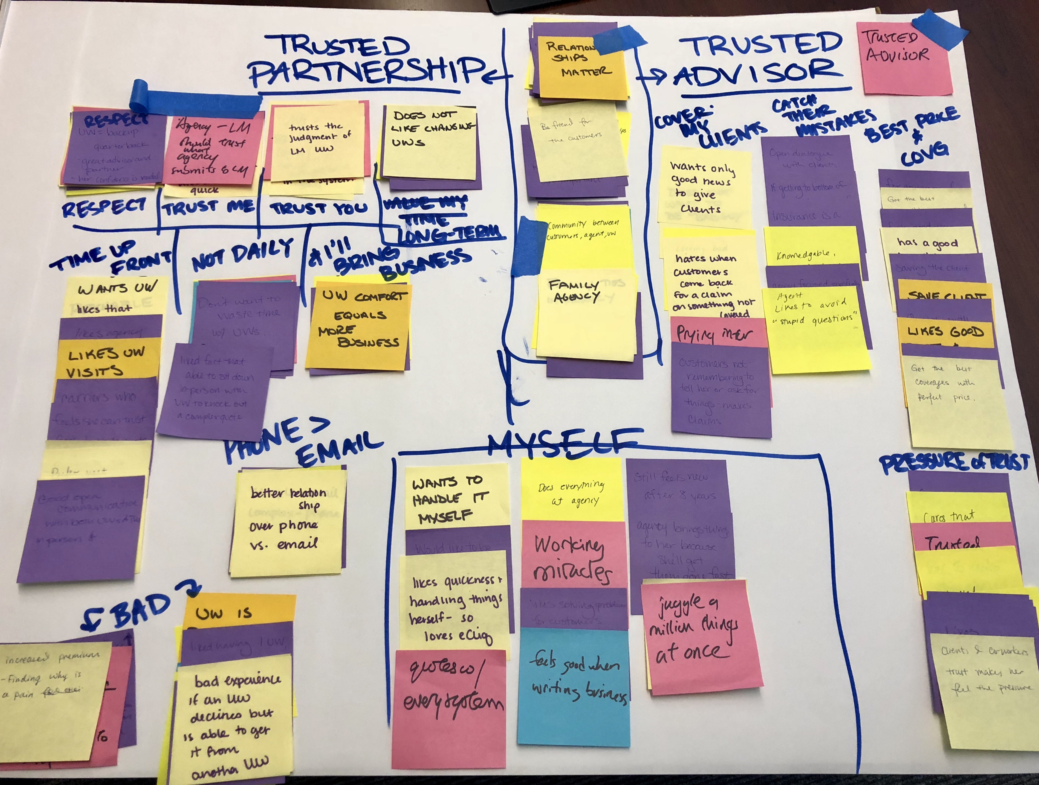
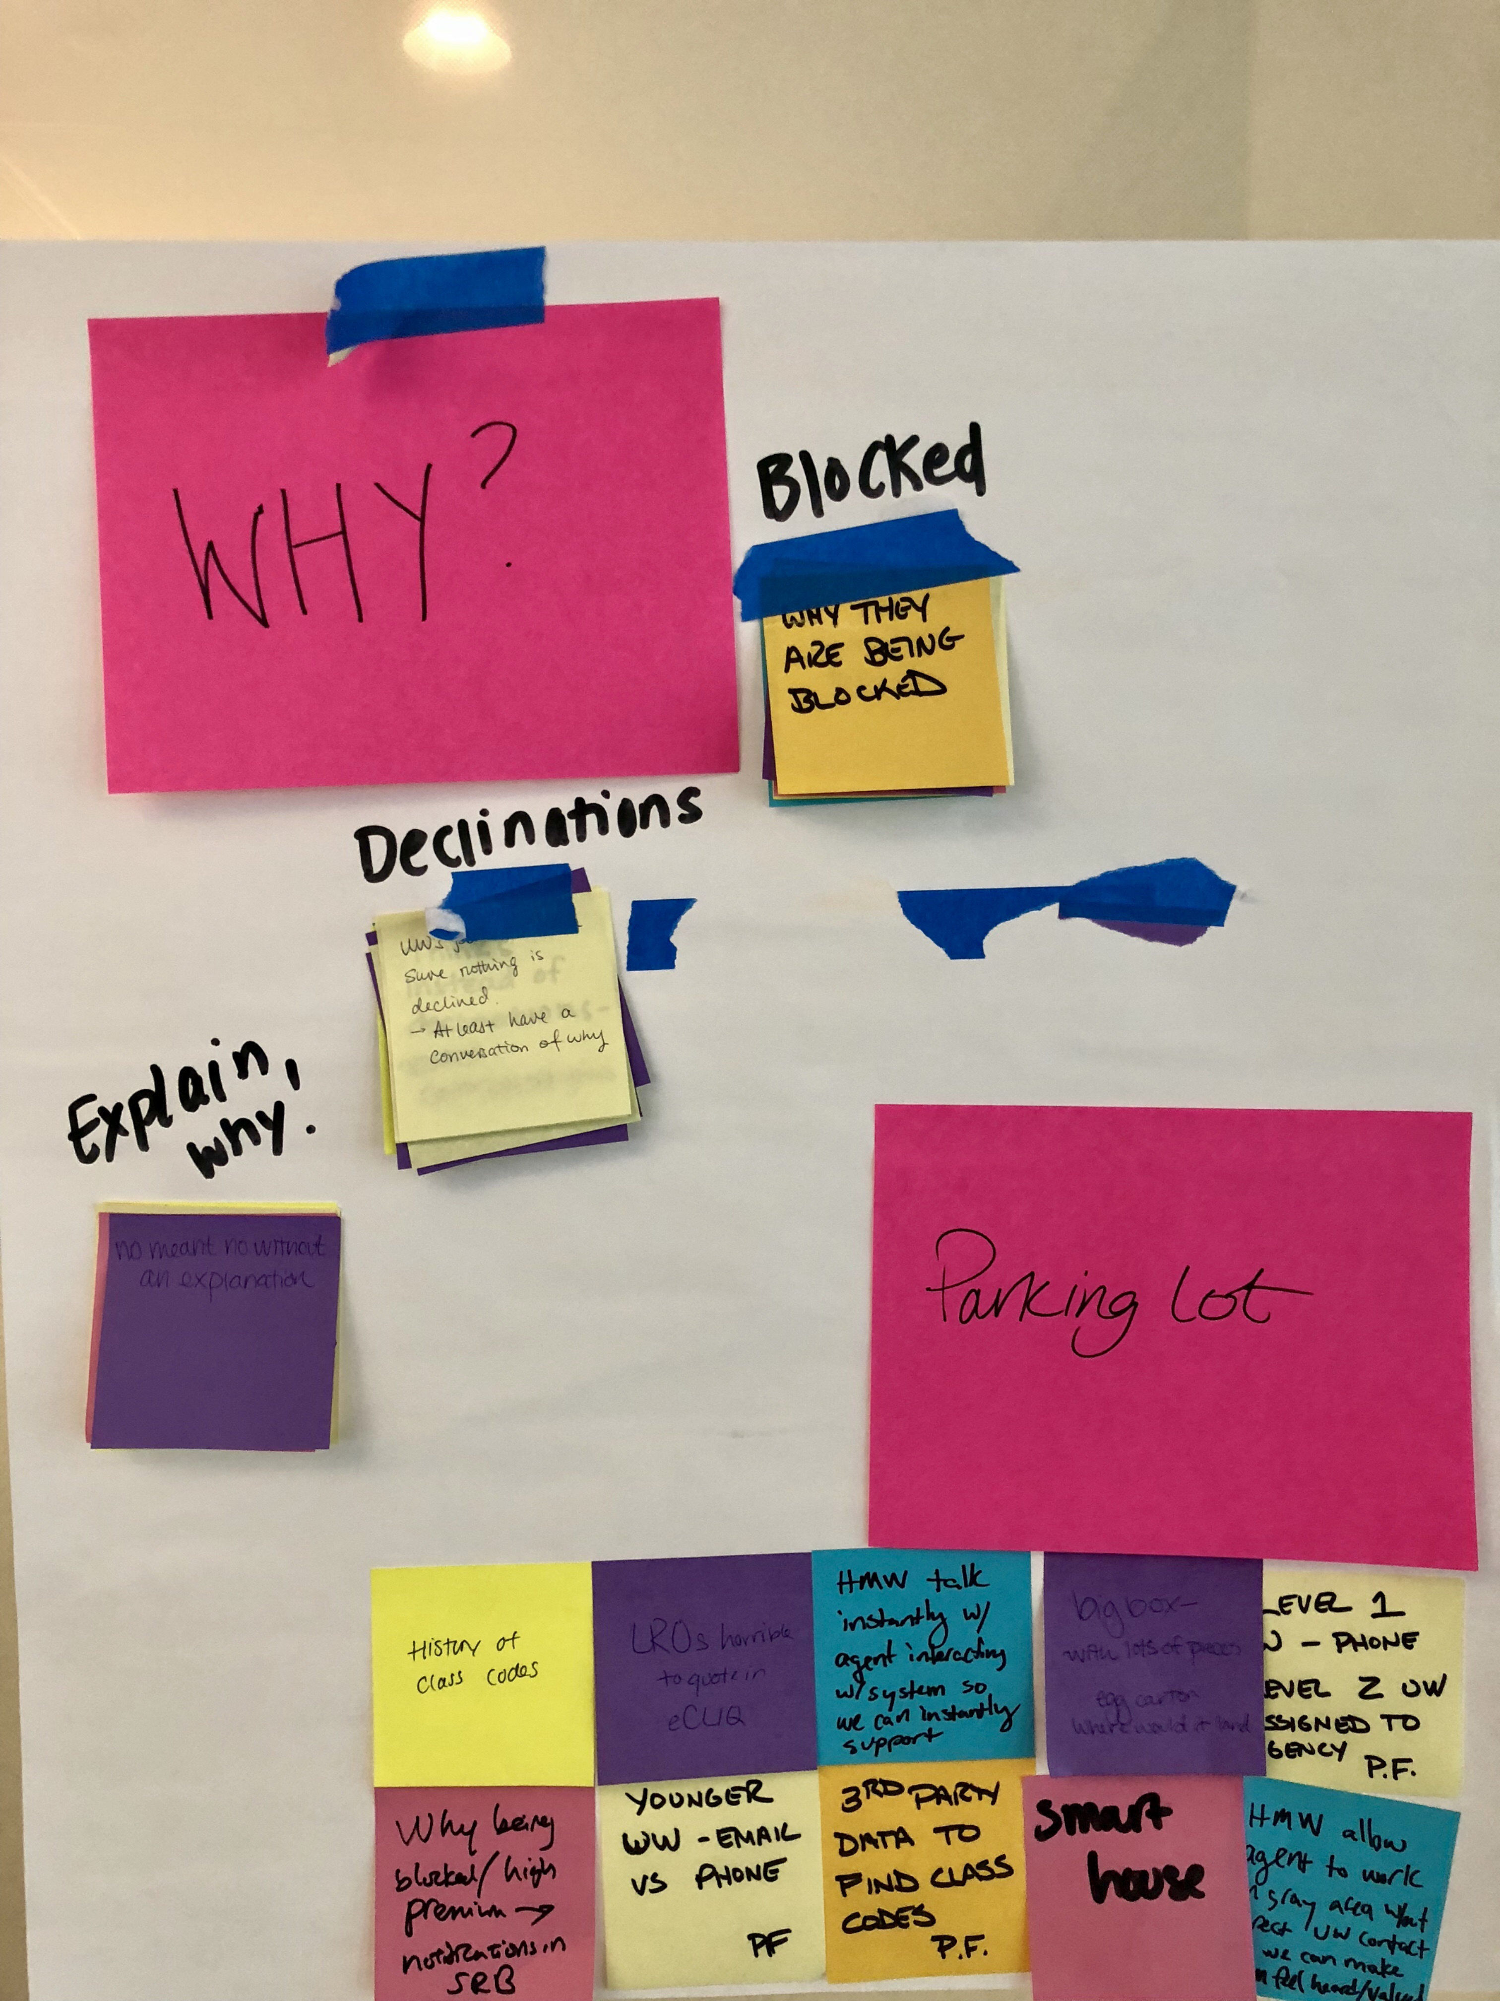

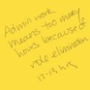

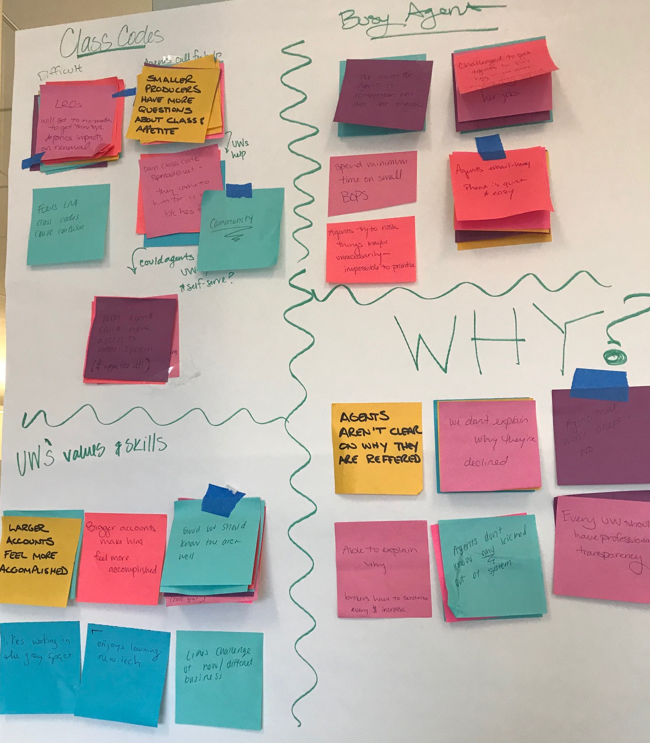
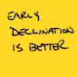


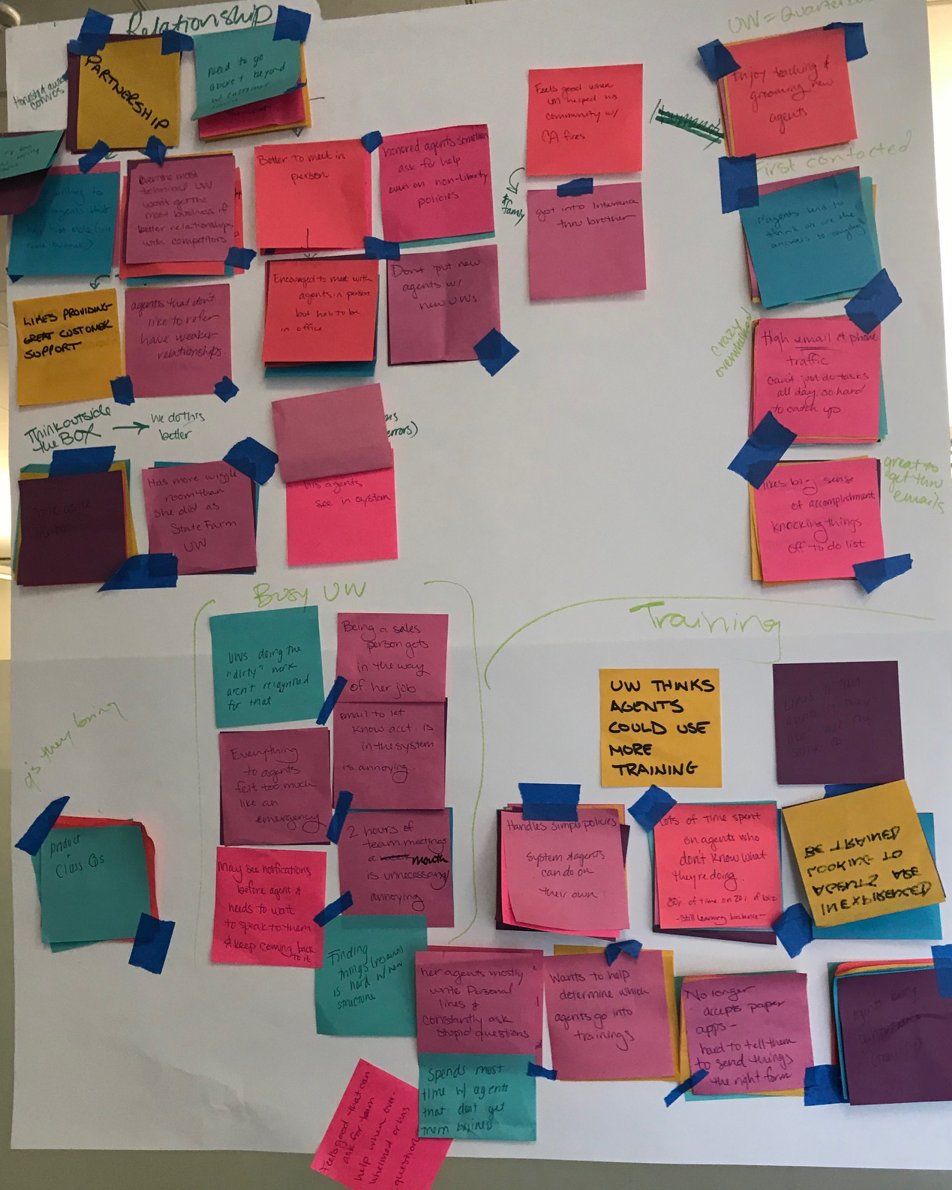
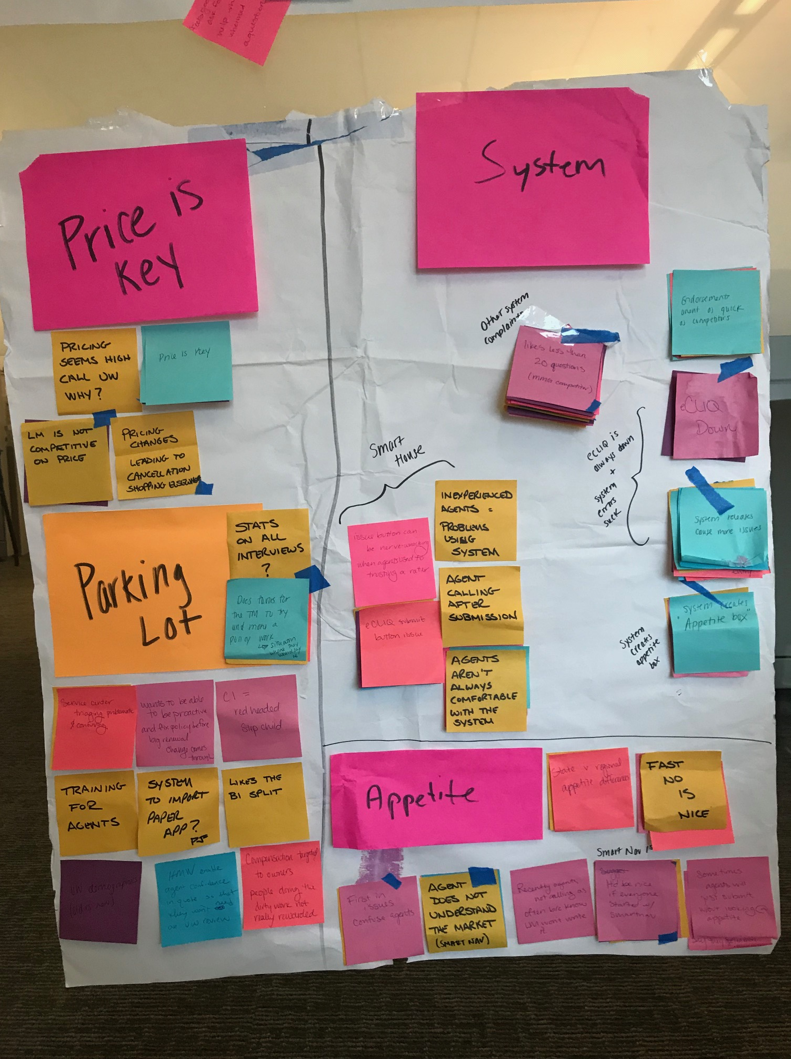



Affinity Mapping
Notes:
I actually just finished a project in partnership with Yang Wei Neo on BIAV and three URAD Go For Coders where we actually used this process to better understand the interaction points between our Hi Chelsea,
Thanks! Sounds good. Does the Monday after next work for everyone? It looks like it catches us right between travel and FTO ☺
Best,
Maggie

Slide 15
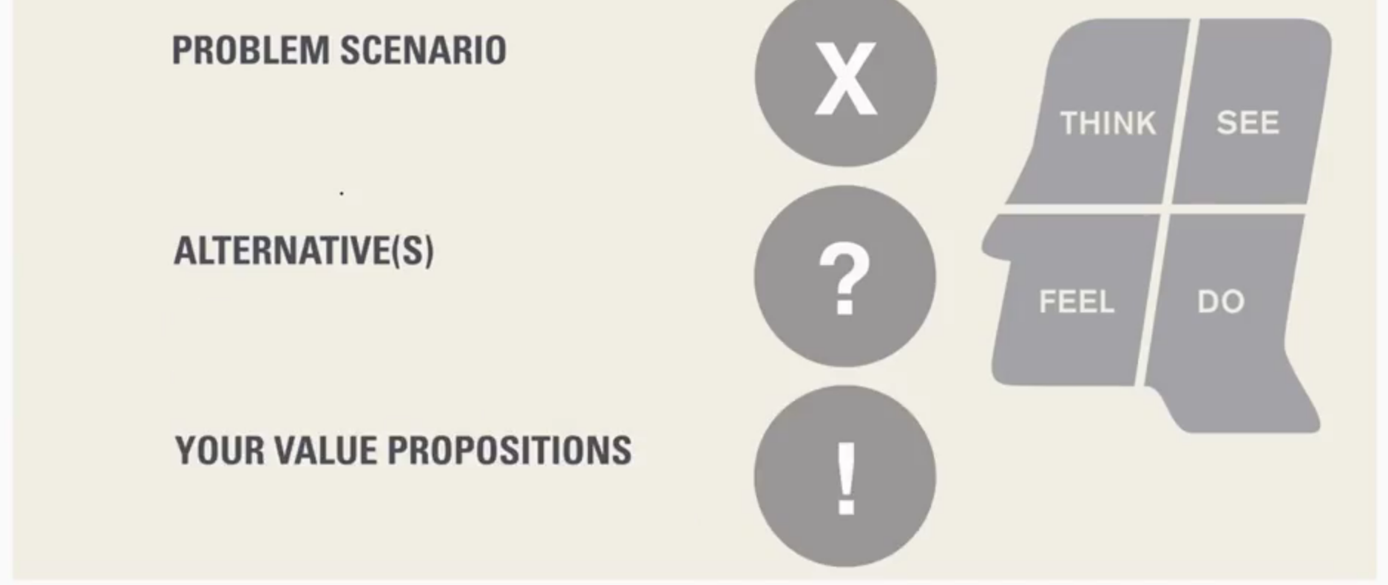
Problem Scenarios
What problem do our customers face today?
What problem do our customers face today?
Do I have real evidence that this is a compelling problem?
What work-arounds do they use now to fix this?
Is this truly solving their problem?
What value can you bring to this space?
Are your solutions better enough than the alternative(s)?
Notes:
Why Is Design Thinking Important?
It reduces the risk associated with launching new ideas.
It helps organizations learn faster.
It generates solutions that are innovative, not just incremental

Slide 16
ALIGNMENT
LEARNING
ANALYSIS
IDEATION & ENVISIONING
EVALUATE & REFINE
Ideation & Envisioning
Test solutions
Notes:
I actually just finished a project in partnership with Yang Wei Neo on BIAV and three URAD Go For Coders where we actually used this process to better understand the interaction points between our Hi Chelsea,
Thanks! Sounds good. Does the Monday after next work for everyone? It looks like it catches us right between travel and FTO ☺
Best,
Maggie

Slide 17
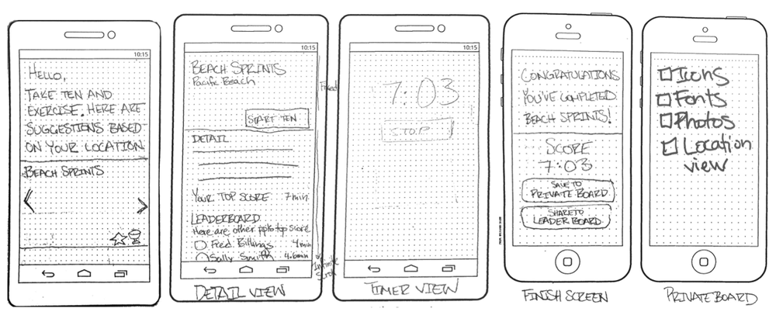
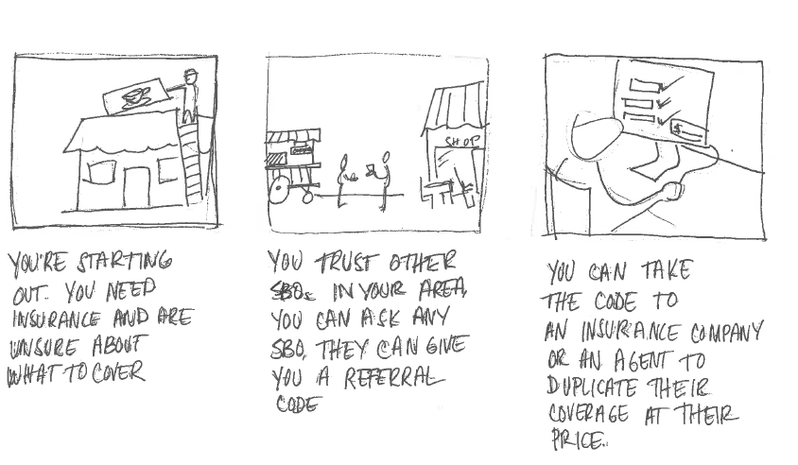
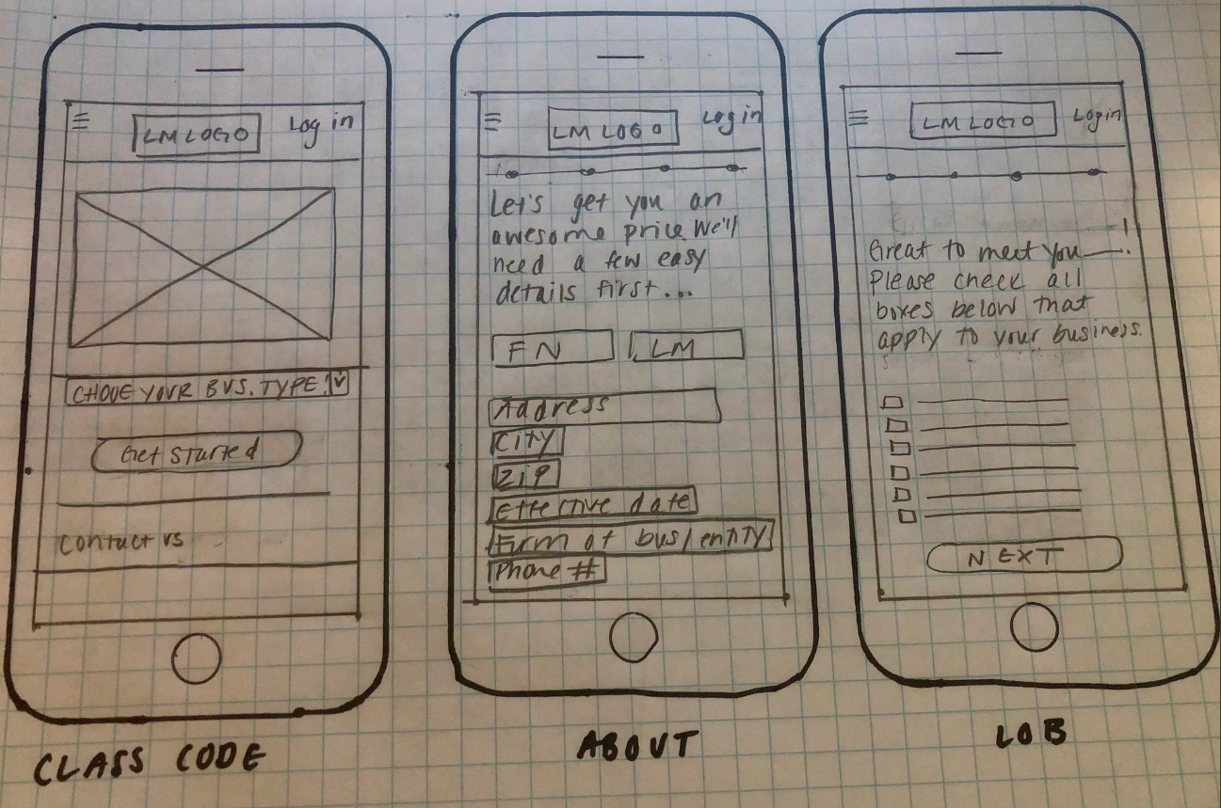
Prototyping
Ideation
Low-fidelity
prototype options

Slide 18

Just real enough to be believable
Too big
Prototyping

Slide 19
ALIGNMENT
LEARNING
ANALYSIS
IDEATION & ENVISIONING
EVALUATE & REFINE
Evaluate & Refine
Get it in market and test, test, test!
Notes:
I actually just finished a project in partnership with Yang Wei Neo on BIAV and three URAD Go For Coders where we actually used this process to better understand the interaction points between our Hi Chelsea,
Thanks! Sounds good. Does the Monday after next work for everyone? It looks like it catches us right between travel and FTO ☺
Best,
Maggie

Slide 20
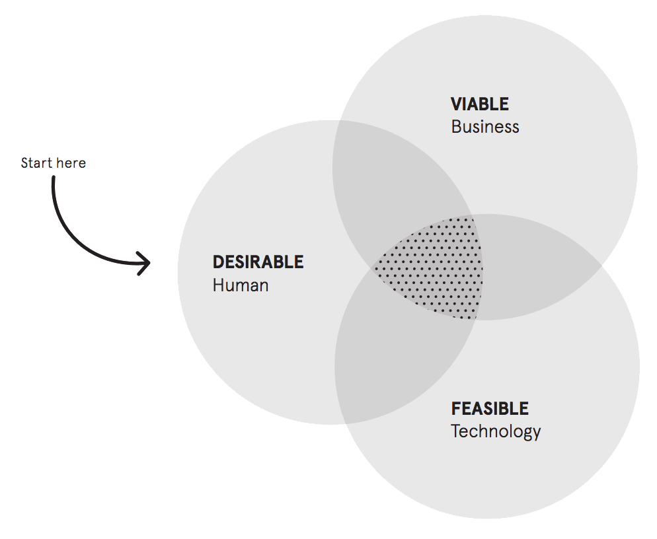
TO GET TO THE RIGHT IDEA,
START WITH THE HUMAN
But then
we need to
see if it resonates

Slide 21
RESONANCE TESTING
We go into resonance with a small number of intentionally distinct ideas.
We come out of resonance knowing the most successful parts of each of the ideas, so that we can combine them to make a stronger whole.
Best at being fast
Comfortable
Fast
Best at being comfortable

Slide 22

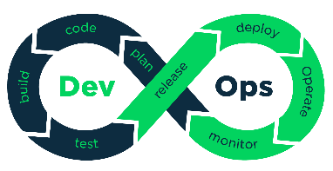
Design Thinking creates a foundation
Design Thinking
Agile Sprints
Dev Ops
Notes:
Design thinking encourages organizations to focus on the people they're creating for.
It’s about simple mindset shifts or ways of asking questions differently – a new way to look at problems.

Slide 23
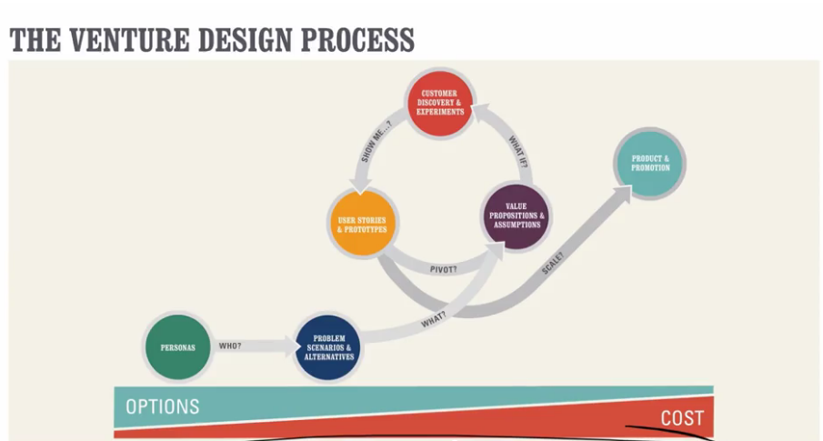
From there we build, deploy, and iterate
Notes:
Design thinking encourages organizations to focus on the people they're creating for.
It’s about simple mindset shifts or ways of asking questions differently – a new way to look at problems.

Slide 24
Questions?

